Slide 1
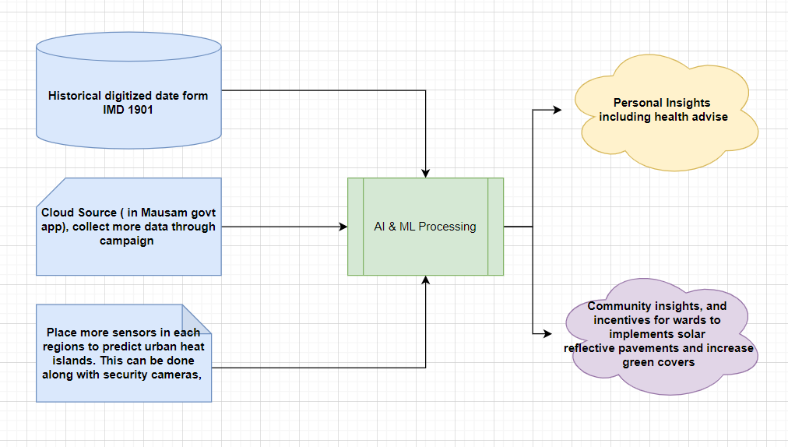
Urban Heat Intelligence – Overall Picture
** IMD data will be for Phase I (already we have), other two data collections will be for Phase II

Slide 2
Utilize existing data and collect more
IMD’s historical data (1901)
India Meteorological Department (IMD) has digitized data from 1901. As of now part of the Mausam mobile app, government provides weather forecast for the next seven days, which includes notifications from government.
Cloud Source
The Mausam mobile app, also has the cloud source option which can be utilized more, using campaigns to collect more data about weather, heat, history and other affecting parameters like industry density and vehicle density etc.
Placing More sensors
The third pillar of data collection comes from placing more ground level sensors, along with security cameras will give more insight about temperature, soil and wind.

Slide 3
AI & ML Model Processing
AI & ML models can be used to analyze the data collected in the previous stages.
Two kind of analysis will be done.
History of a particular region (12KM) will be analyzed over the day, year, decade and century level to identify the urban heat islands.
Two identical places will be compared to drive more insights.
One is like, two places has same temperature today, how it was in history (Like 10 years before) – Current to Past analysis
Second one is Past to current analysis – It is like 10 years before has identical temperature, now turned into what state.

Slide 4
Intelligent Insights – Individual
Based on the AI/ML processing data, we will get more insights.
These insights can be pushed via Mausam mobile app to the individuals.
This can be added as additional menu and as well as shared as notifications.
Based on the heat predictions, heath advice notifications will be sent to individual
As per the human psychology, the ideal temperature for the human to sleep will be 20 to 27 degree Celsius. Basically urban heat islands can cause so many health illness includes insomnia, irritability and depression.
Health advise notifications and updates are really important, like stay hydrated, avoid direct sunlight, planning your commutes based on predictions and as well as preparedness for the upcoming months in advance.
The feature predictions based on the pin code also will be provided, so that individuals can plan better.

Slide 5
Intelligent Insights – Community
Based on the AI/ML processing data, we will get more insights that can be used by community as well as government officials.
This will help us in identifying the hot centers which needs immediate attention where we can increase green cover and solar reflective pavements (as the radiations only cause heat, it will be an effective solution)
Government can target to increase the green cover and solar reflective pavements in these areas primarily.
The intelligence insights will lead us in two directions.
What has caused to the current state in a particular region.
How an another area is doing better with the same condition, which can be reverse engineered and apply the same concepts over other areas.
This interface also will be delivered part of the IMD’s website to the researchers and government officials.

Slide 6
Intelligent Insights – Additional Insights.
We have lot of resources and data with IMD.
The goal for us should be how intelligent insights (using AI & ML) can be carved out from the humongous data that lies with IMD.
The additional data also can be collected about industry intensity, vehicle intensity etc. to supplement the research outcome.
The focus to mitigate urban heat island will be in two directions.
Individual based – Help individuals with more insights and heath guidance.
Community based – Help community, government officials and policy makers to increase green cover, administration changes, solar pavements etc.
Considering WFH options, 4 working days week and Moving office working time to align with sun rise during peak of the summer is and additional advise for companies and policy makers. This also can be driven from data insights.

